Slide 1
Mars Rover Backhoe
Swapnil Pande and Alex Barnett
ME 3202 – Machine Analysis and Design

Slide 2
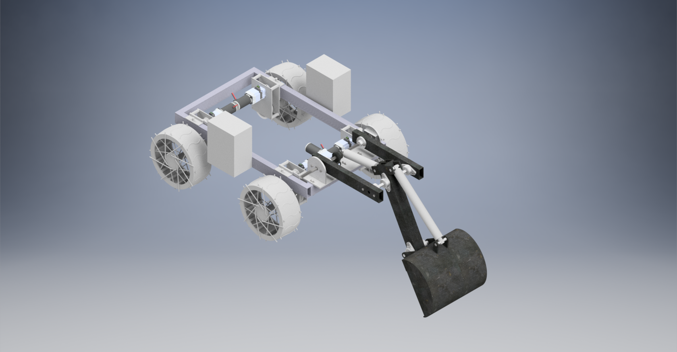

Slide 3
Mission Objective
Design a backhoe excavator for an autonomous Mars rover
Must dig through 30 cm of Martian sand and excavate icy gravel
Autonomous in-situ resource utilization for Mars colonization missions

Slide 4

Design Constraints
Max dimensions: 15in x 8in x 25in
Mass less than 30 lb
Must extend at least 16.8 inches into the ground
Collect 6 kg of gravel in 4 minutes
Must use only electrical power
Reliability – 5 year life cycle
Manufacturability

Slide 5

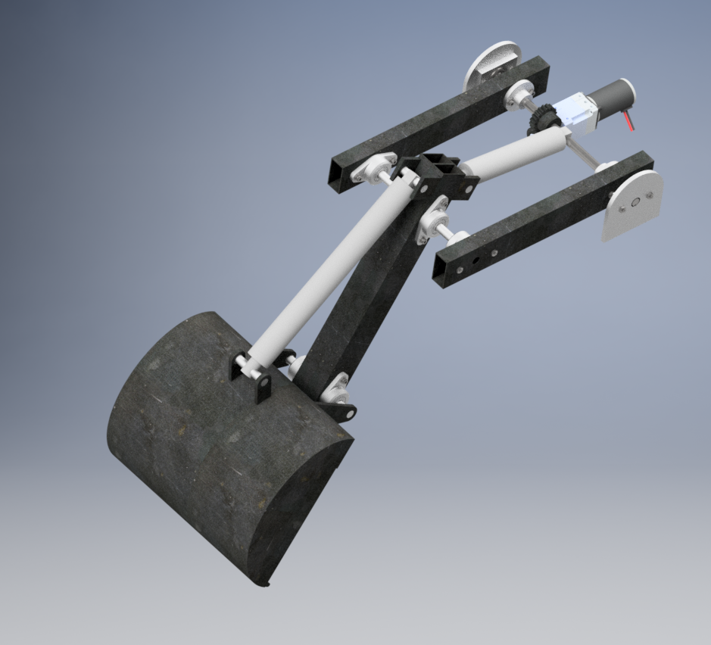
Functionality
Boom, stick, scoop
Boom rotates by motor and worm gear
Stick & scoop controlled with linear actuators
Machine components
Bearings
Shafts & keys
Gearbox
Linear actuators

Slide 6
Design Strength Verification
Fatigue calculations
Bearings
Shaft
Worm gear

